Slide 1
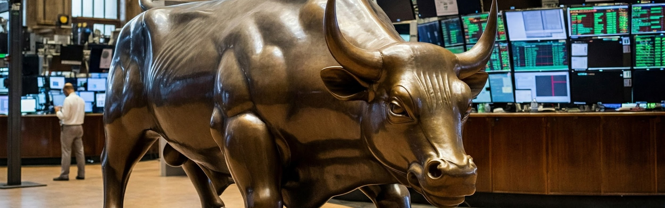
Financial Forensics: Dalal Street
Team #3
Ansh – 21F2000398, Aditya – 21F2001090, and Charvi – 22F1001106

Slide 2

INTRODUCTION
Project Goal: Assess ability to understand financial statements, ratios, and future performance.
Budget: INR 10,00,000 to invest in BSE-listed companies.
Evaluation: Portfolio performance at time-period T3.
Approach: Three-pronged analysis (Ratio, P&L/Balance Sheet, Valuation/DCF).
Team Roles: Charvi (Ratios), Ansh (P&L/Balance Sheet), Aditya (Valuation/DCF).

Slide 3

Our Approach: A Three-Pronged Analysis
Ratio Analysis (Charvi): Analyzed financial ratios to assess profitability, liquidity, and efficiency. Ratios were selected based on profitability and valuation.
P&L and Balance Sheet Analysis (Ansh): Filtered stocks with positive revenue and profit growth, ROCE and ROE above 10%. Excluded stocks with a significant drop in promoter holdings or a P/E much higher than the industry average. Ranked the remaining stocks by their Graham number ratio.
Valuation and DCF Analysis (Aditya): Used DCF and other methods to estimate intrinsic value and identify undervalued stocks.

Slide 4

Ratio Analysis
Profitability Ratios:
Dividend Yield (DY): A high dividend yield can indicate a stable and rewarding investment.
Return on Assets (ROA): A higher ROA indicates better asset utilization and operational efficiency.
Return on Equity (ROE): A high ROE suggests that the company effectively generates returns on the investments made by its shareholders.
Valuation Ratios
Price-to-Earnings Ratio (P/E): A lower P/E ratio can signal undervaluation, making the stock attractive if the company has growth potential.
Price-to-Book Value (P/B): A lower P/B ratio can indicate an undervalued stock, especially in asset-heavy industries.

Slide 5

Valuation Techniques
Discounted Cash Flow (DCF): Estimates the present value of future cash flows.
Relative Valuation: Compares a company's valuation to its peers.
Price-to-Earnings (P/E) Ratio: Measures the price investors are willing to pay for each dollar of earnings.
Price-to-Book (P/B) Ratio: Compares a company's market value to its book value.
Enterprise Value (EV) to EBITDA: Compares a company's total value to its earnings before interest, taxes, depreciation, and amortization.

Slide 6

Stock Picking and Filtering Process
Initial: Over 5,000 stocks listed on the Bombay Stock Exchange (BSE)
Filtering Criteria:
Market Capitalization: Focus on large-cap stocks for reduced volatility.
Risk Appetite: Targeted a return of 5-10%.
Multiple Indicators: Financial ratios, P&L, balance sheet, valuation models.
Final Portfolio: 11 carefully selected stocks.

Slide 7

Identifying Undervalued Stocks with DCF
Discounted Cash Flow (DCF) Analysis identified undervalued stocks with high growth potential.
DCF analysis projects the present value of future cash flows, providing an intrinsic value estimate.
Comparison of intrinsic value to market price reveals potential investment opportunities.

Slide 8
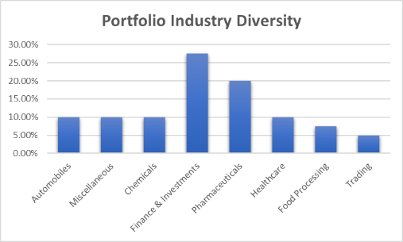
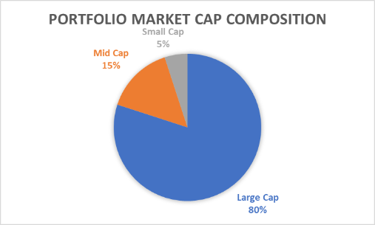
Final Result

Slide 9
Thank you for your time!

